Slide 1


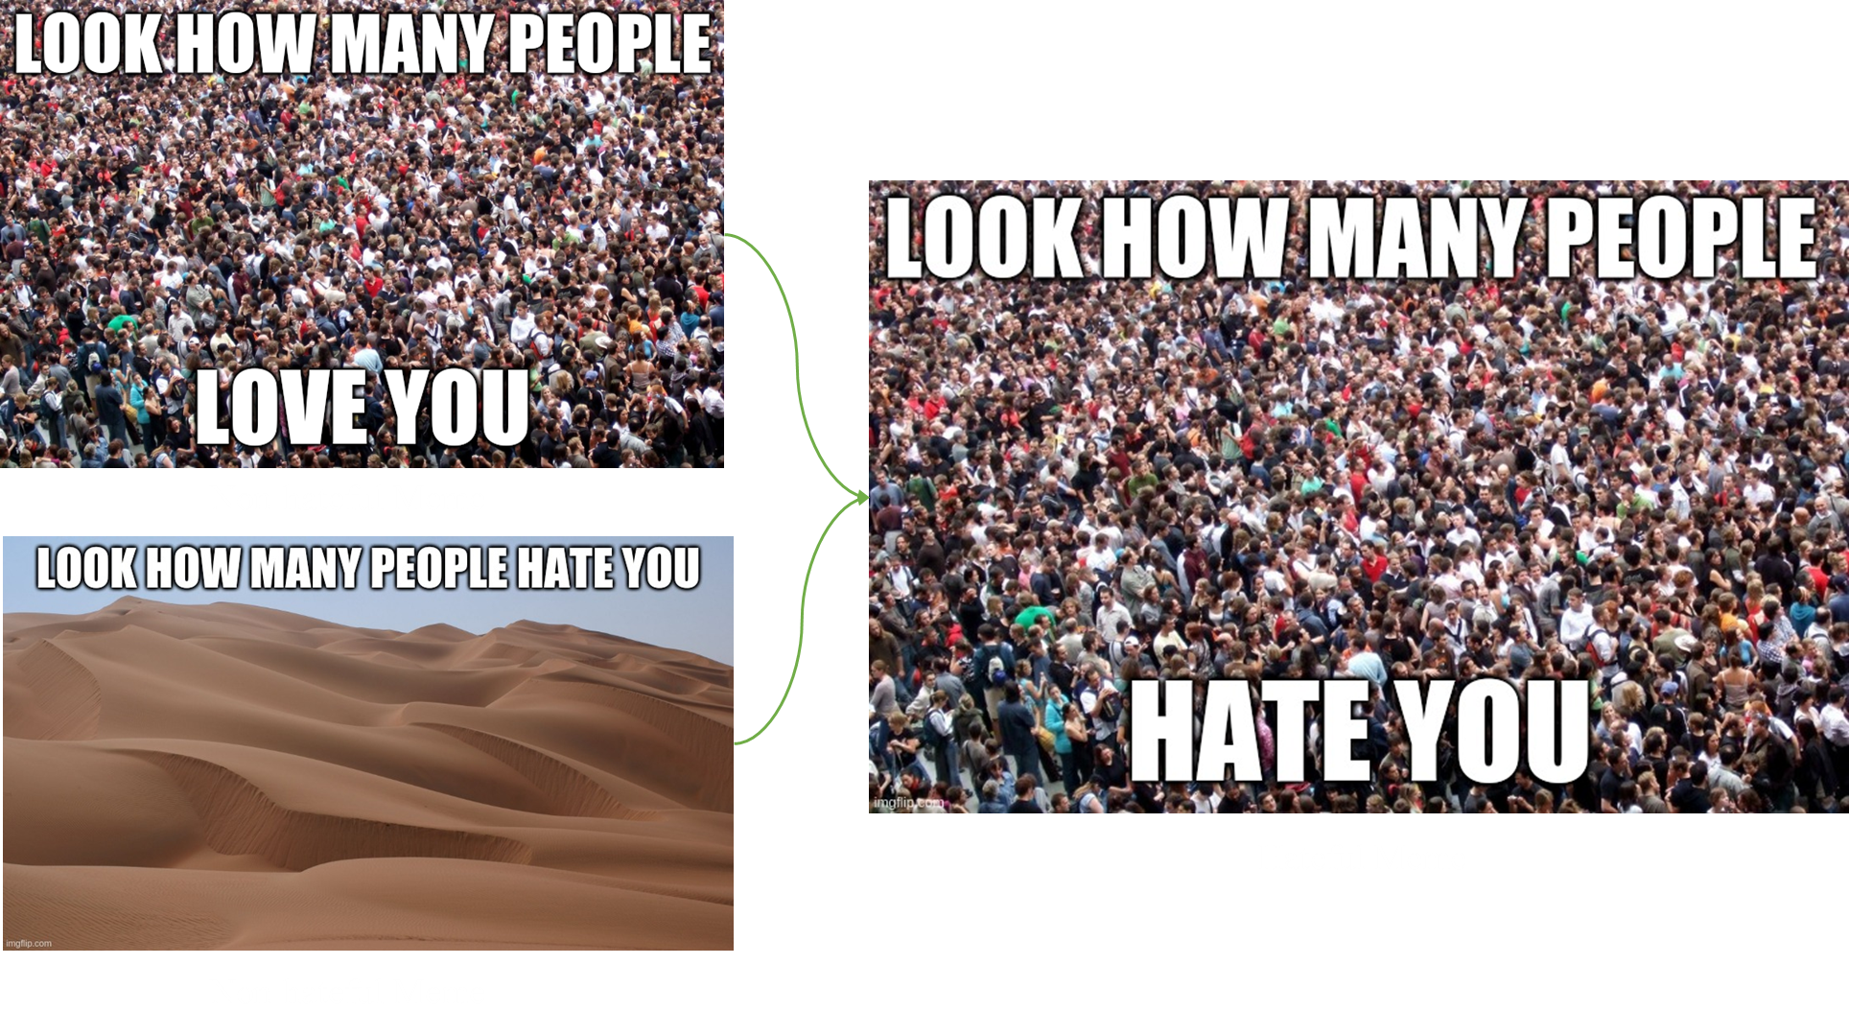
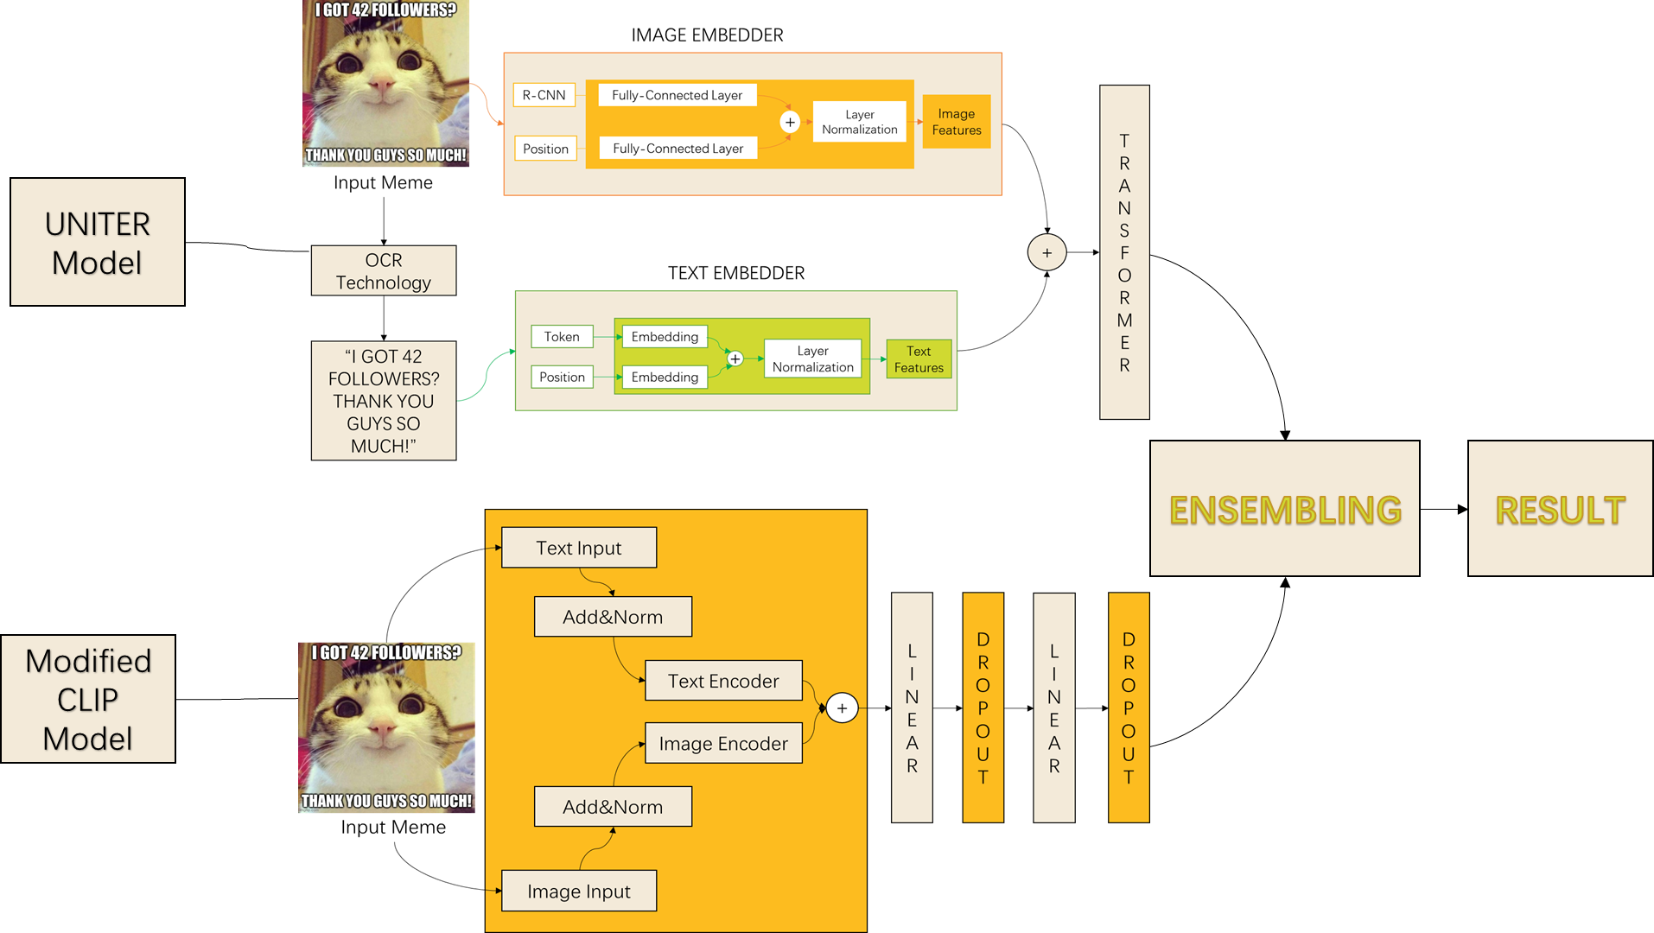
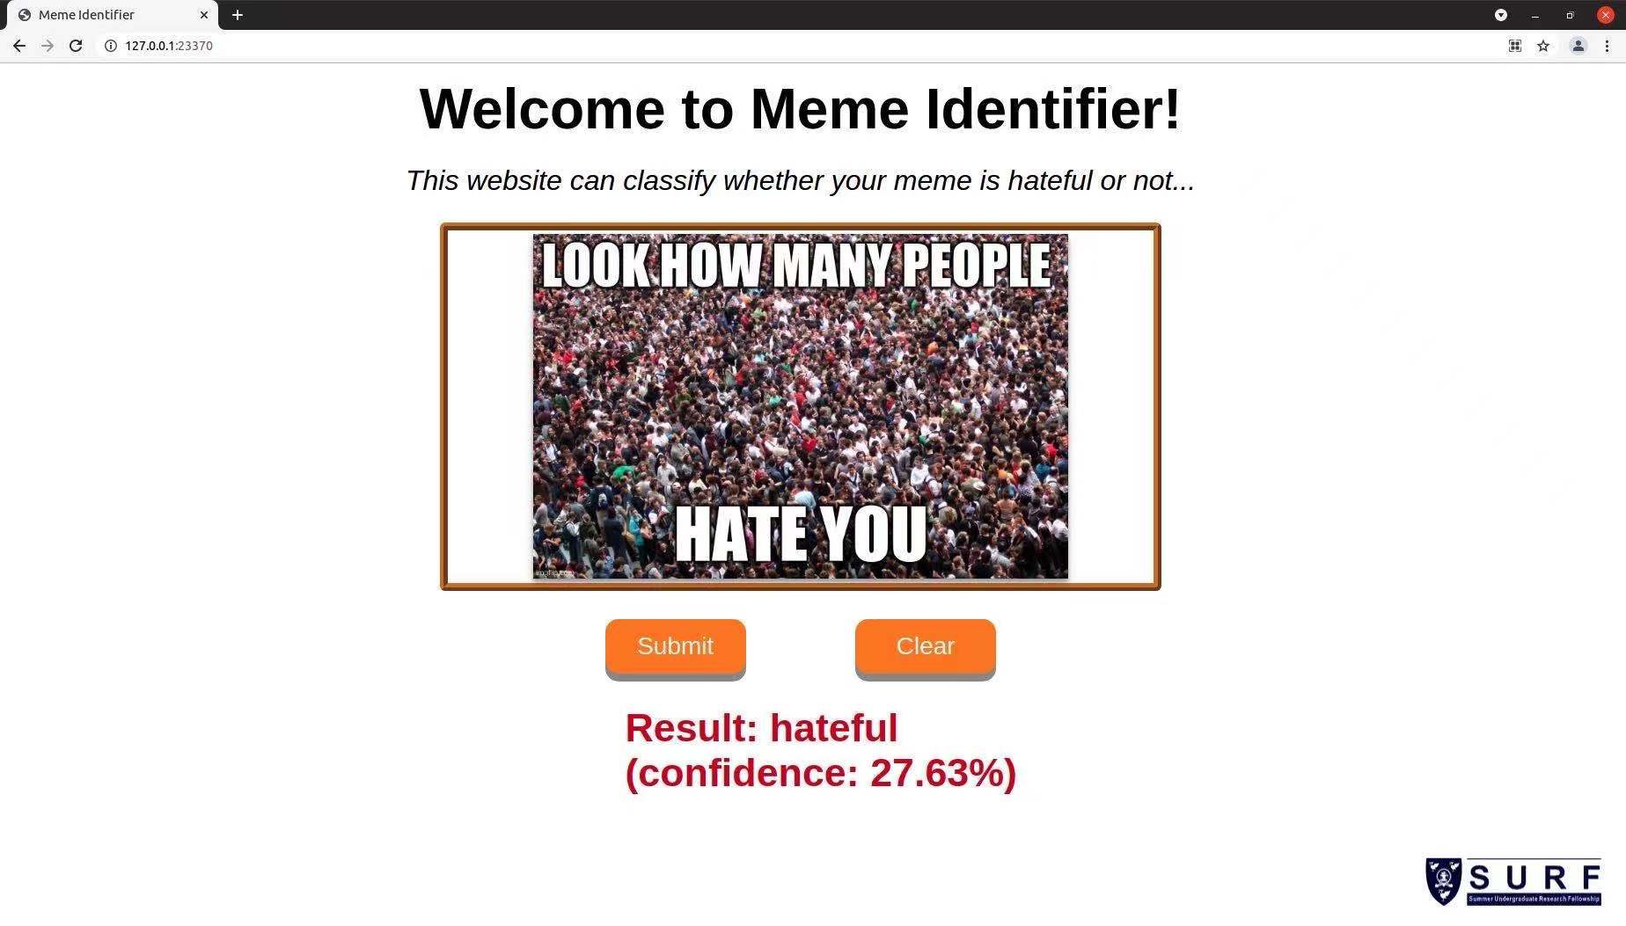
Offensive Content Detection in
Multimodal Publications
SURF Members: Dian Jiao, Jingyang Min, Kai Shen, Lihan Zhao, Mingzhi Gao, Yuxin Ding, Ziling Dong
SURF Supervisors: Erick Purwanto, Jianjun Chen
SURF No: 2021051
ABSTRACT
RESULTS
Memes are widely abused to publish and conceal offensive contents. Traditional unimodal sentiment analysis machine learning models will fail to identify them, because the images and texts may not be offensive separately.
Very recently, a self-supervised contrastive model named CLIP was trained on high-volume unannotated images on the Internet.
This SURF project leveraged and extended CLIP to perform multimodal prediction. We combined it with a customized UNITER, a multimodal vision-language model, to achieve high prediction accuracy on Facebook Hateful Memes Challenge dataset. A detection website was also built to showcase our
entire framework.
MOTIVATION
Detecting whether an image or text is hateful or not is easier for AI systems, however when combing the image and text together the difficulty will be totally different.
As is shown that Figure 1 and Figure 2 are memes with neutral content but when swapping their text and image like Figures 3, they will become hateful. Our goal is to make AI system be able to check such kind of memes.
OUR MODEL
DISCUSSION
Results implies that the new ensemble model of CLIP and UNITER, can achieve an accuracy of 74.21%, which is much higher than the original VilBERT (65.27%). The multimodal classifier combining image and text can achieve good performance on the hateful memes dataset.
The apperance of our application is shown (above, below, on the left, on the right). Users can drag images to the main window or click the window to select one from local directory. After clicking the submit button and waiting for a while, the prediction(hateful or non-hateful) with confidence will be displayed below the window.
CLIP is a model aims at are trained to predict a fixed set of predetermined object categories. Unlike the original CLIP, which is constructed by 3 parts:
Image Encoder: ResNet50 is a variant of ResNet model which has 48 Convolution layers along with 1 MaxPool and 1 Average Pool layer. It has 3.8 x 10^9 Floating points operations.
Text encoder: We use captions on the memes as the input for text encoder with normalizations.
FC layers: Fully Connected layers in a neural networks are those layers where all the inputs from one layer are connected to every activation unit of the next layer.
We improved it by
Solve problems by multimodal fusion with image and text inputs.
Replace the transformer layers by 3 Fully-Connected Layers
FUTURE WORK
We will explore the following additional contributions:
1. Applying different embedders to encode text and image.
2. Considering relationship between hatefulness, image and text.
Radford, A., Kim, J.W., Hallacy, C., Ramesh, A., Goh, G., Agarwal, S., Sastry, G., Askell, A.,
Mishkin, P., Clark, J. and Krueger, G., 2021. Learning transferable visual models from natural language
supervision. arXiv preprint arXiv:2103.00020.
2. Kiela, D., Firooz, H., Mohan, A., Goswami, V., Singh, A., Ringshia, P. and Testuggine, D., 2020.
The hateful memes challenge: Detecting hate speech in multimodal memes. arXiv preprint arXiv:2005.04790.
3. Lippe, P., Holla, N., Chandra, S., Rajamanickam, S., Antoniou, G., Shutova, E., & Yannakoudakis, H. (2020).
A multimodal framework for the detection of hateful memes. arXiv preprint arXiv:2012.12871.

